Slide 1

Business Insights through Data
Abhishek Rathi
Master’s in International Business

Slide 2


Agenda
Column Names & Description
Descriptive Statistics
Pearson Correlation Analysis
Regression
Which Industry does this dataset come from?
Salary Policy of the company [In Executive Report]
Business Recommendations [In Executive Report]
Google Collab [Python Workbook] https://colab.research.google.com/drive/1x5JmB064js5KVrJEqmhVoqAiX9axe9wu?usp=sharing

Slide 3
Column Names & Description
Id - It represents unique identification for each entry in the dataset.
Gender - Male/Female
Education - No. of years the employee has studied in his life
Job_Category - It showcases the categories for 3 different types of jobs within the company (1,2,3)
Salary - Current salary of the employee
Salary_Beginning - Starting salary at the company when the employee joined
JobTime - Time spent in the current job (In months)
Previous Experience - Work experience gained (In months)
Minority - usually refers to four major racial and ethnic groups: African Americans, American Indians and Alaska Natives, Asians and Pacific Islanders, and Hispanics. Minority = 1 signifies belonging to any of these categories.

Slide 4
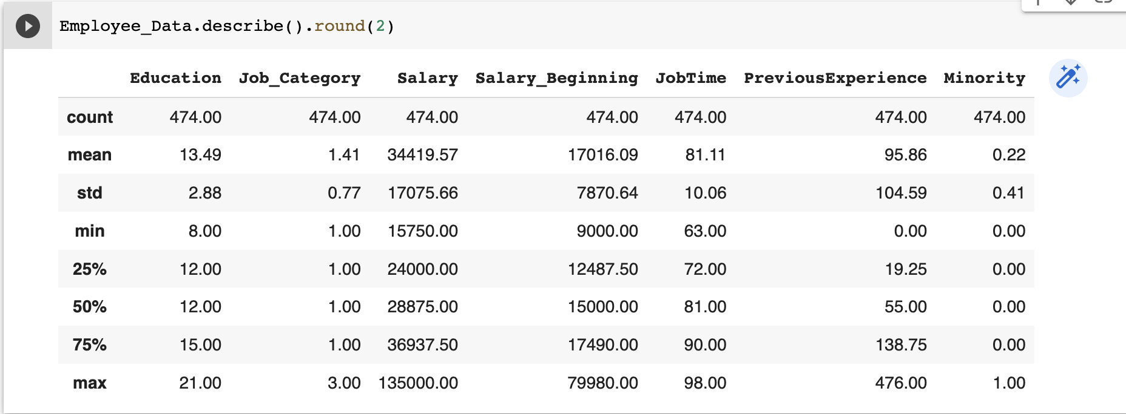
Descriptive Statistics (SPSS and Python)

Slide 5
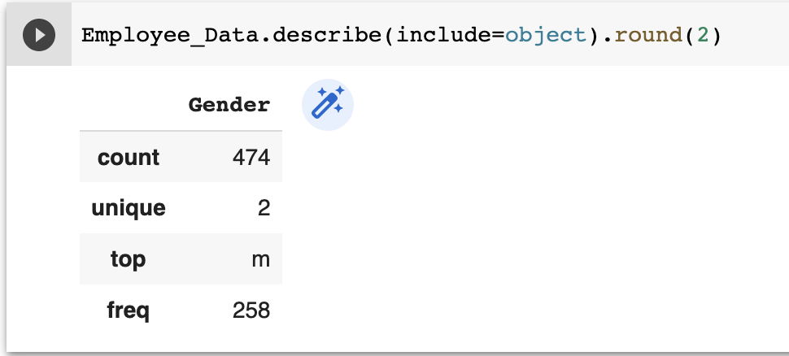
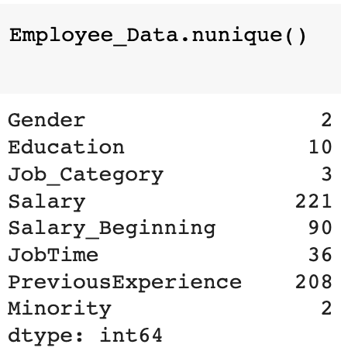
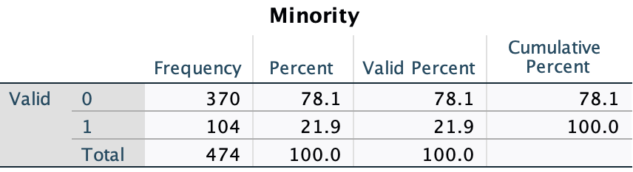
Descriptive Statistics
There are 258 Male employees & 216 Female employees.
Most employees work in the Job Category 1 - 363 employees.
104 employees belong to the Minority group.
The no. of unique values in each column is shown using .nunique() function in Python.

Slide 6
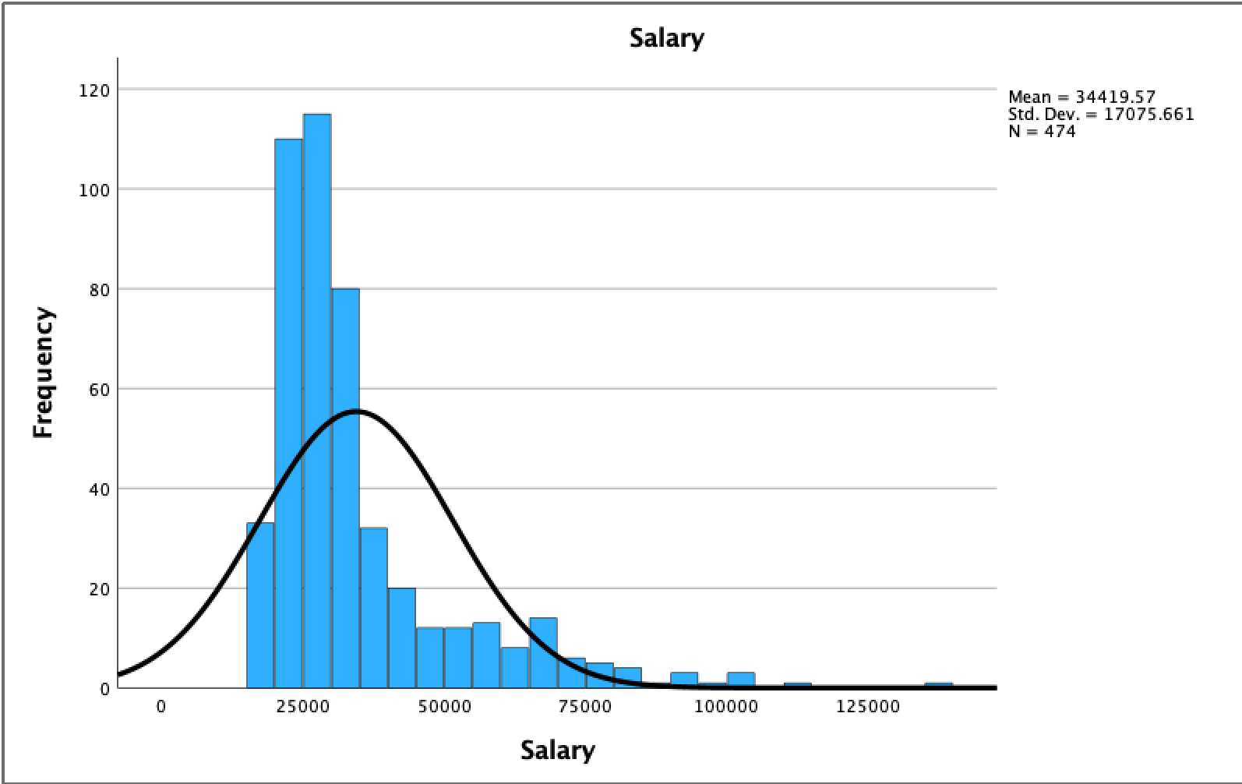
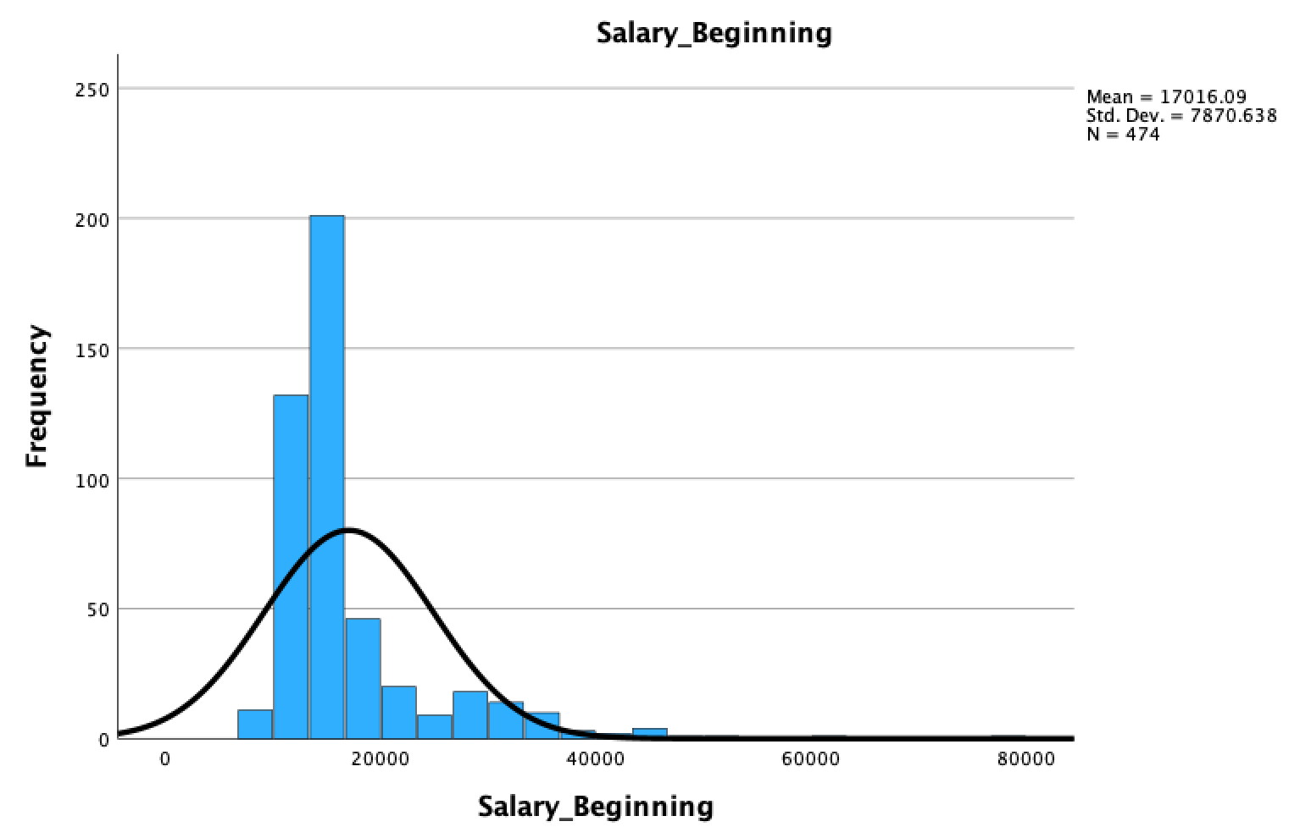
Mean Salary is 34419.57 but the max salary is 135000 which is an outlier. On inspecting the data, we find few salaries (5 entries) to be higher than 100000. Similar outliers can be found in Salary_Beginning with mean being 17016.09 but max Salary_Beginning is 79980.
As shown in graphs, Salary and Salary_Beginning are right-skewed (Positive skewness).
Similarly, Previous Experience also shows positive skewness with mean = 95.86 and max = 476 which is an outlier.

Slide 7
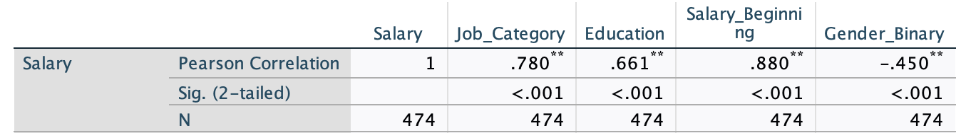
Pearson Correlation Analysis
Job_Category, Education, Salary_Beginning are highly correlated (positive) with Salary. The correlation is significant at the 0.01 level (2-tailed)
Salary vs Gender is negatively correlated. The correlation is significant at the 0.01 level (2-tailed) [Gender - Male (0) and Female (1) were recoded into binary values and converted from String to Numeric to conduct correlation and regression analysis. ]
There are other correlations also but are not highly correlated with salary in a positive or negative way.
For example, Salary vs minority correlation is significant at the 0.01 level (2-tailed) but the Pearson Correlation value is just -1.77 which is not significant. Also, running the regression analysis between Salary and minority, the R-square value came up to be .031 which is just 3% and thus, we can say that minority doesn’t predict Salary much and should not be considered. Similarly, Salary vs Previous Experience is significant at the 0.05 level (2-tailed) but the Pearson Correlation value is just -0.97 which is not significant. Also, on doing regression analysis between Salary and Previous experience, the R-square value is just .009 which is insignificant. [Slide 8]

Slide 8
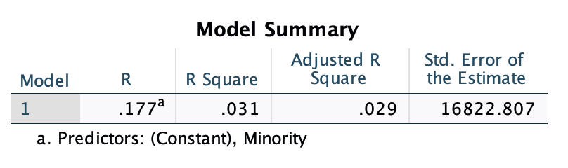
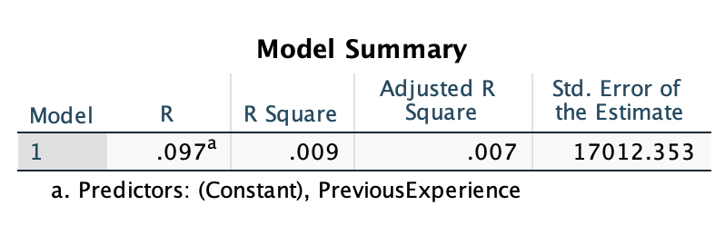
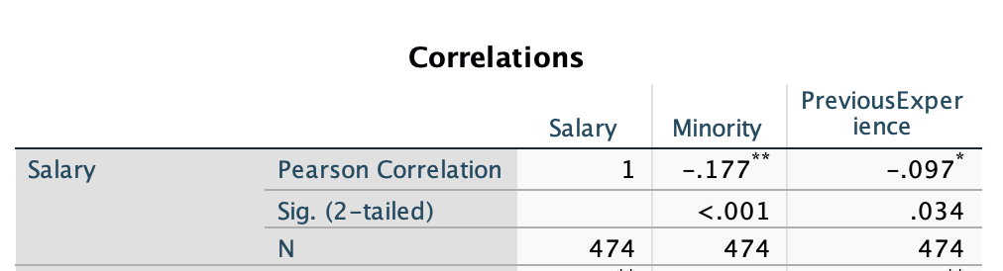
Correlation & Regression: Salary - Minority, Previous Experience (Insignificant)

Slide 9
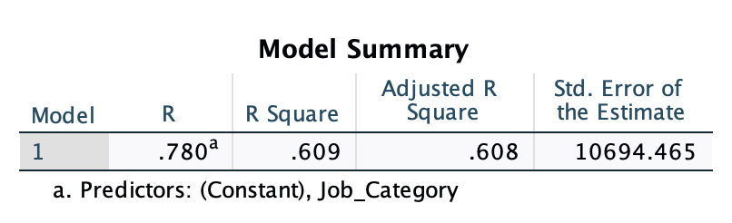
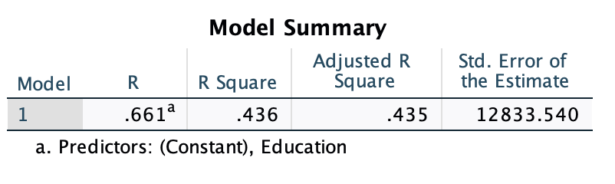
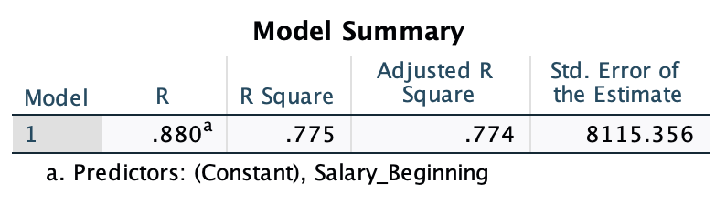
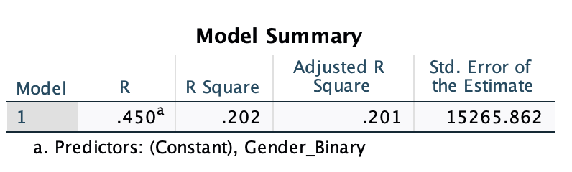
Regression (Significant) - Salary vs Education, Job_Category, Salary_Beginning, Gender
Based on the R-square value, we can conclude that Salary_Beginning has the most impact on Salary followed by Job Category, Education, Gender.

Slide 10
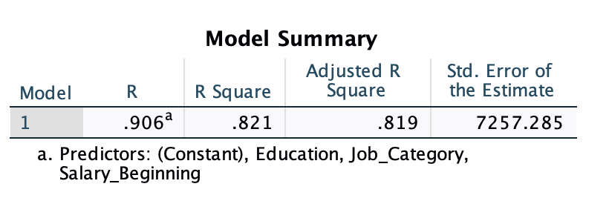
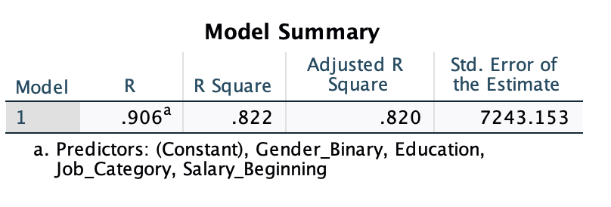
Cumulative R-Square
Education, Job Category, Salary Beginning - .821 (R-square). These 3 variables can predict Salary by around 82%
Moreover, if we do regression analysis with Education, Job Category, Salary Beginning, Gender the R-square value is .822 (R-square) which is similar to the R-square with Education, Job Category, Salary Beginning.
Thus, we can conclude that Gender isn’t a significant factor for predicting salary compared to Education, Job_Category, Salary_Beginning. As, even without Gender the R-square value is coming to be .821
X - Education, Job_Category, Salary_Beginning
X - Education, Job_Category, Salary_Beginning, Gender

Slide 11

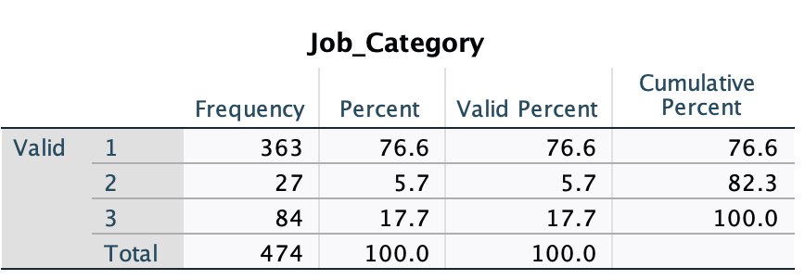
Which Industry does this dataset come from?
Based on the descriptive statistics, we can observe that there are 363 people belonging to Job Category 1, 27 in Job Category 2, 84 in Job Category 3.
This dataset can come from a Corporate Hospital. As people belonging to Job category 3 earn the highest and can be Board of Directors, President, VP’s, specialist doctors like surgeons, neurologists, etc. Job category 2 can be the Managers, Accountants, marketing specialists, assistant doctors who earn less than Category 3 and the category 1 can be employees such as nurses, male nurses or even medical students who have joined the hospital.
Also, our dataset shows that the no. of people in high paying Job category 3 is 84, and in IT, consulting, fintech companies the no. of executives are not that much if its a small to medium firm. Thus, I neglected these companies when trying to guess from where does this dataset come from whereas a big corporate hospital can have many specialist doctors who earn the highest package.

Slide 12


